Slide 1
The Internet Of Things

Slide 2
Definition
The Internet of things (IoT) is the inter-networking of physical devices, vehicles (also referred to as "connected devices" and "smart devices"), buildings, and other items embedded with electronics, software, sensors, actuators, and network connectivity which enable these objects to collect and exchange data.

Slide 3
The internet of things, or IoT, is a system of interrelated computing devices, mechanical and digital machines, objects, animals or people that are provided with unique identifiers (UIDs) and the ability to transfer data over a network without requiring human-to-human or human-to-computer interaction.
Internet of Things (IoT) is a system of devices connected to the Internet with the ability to collect and exchange data from users or environment with no human intervention.

Slide 4
Things
The device or the ‘thing’ in IoT could be any device embedded with electronics, software and sensor like a smart refrigerator, a smart air conditioner, lights in household, connected security systems or even a person with a heart monitor or an automobile.

Slide 5
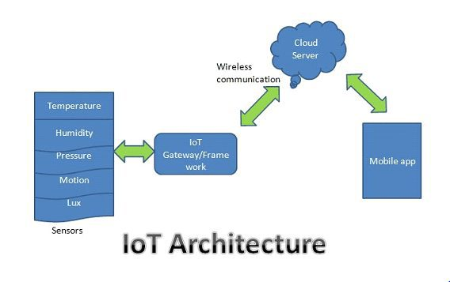
Basic Architecture

Slide 6
Why IoT ?
We are lazy
We want to automate everything
We want to control everything remotely
We want to see data in real-time

Slide 7
The impact
The impact from IoT or any technology comes in the form of
New revenue streams (green energy solutions)
Reducing costs (in-home patient healthcare)
Reducing time to market (factory automation)
Improving supply chain logistics (asset tracking)
Reducing production loss (theft, spoilage of perishable)
Increasing productivity (machine learning and data analytics)

Slide 8
Things to Consider….
A Positive Reward: a 5x gain is the target and has worked well for the introduction of new technologies to pre-existing industries.
Scalability: IoT design is, by nature, a plurality of devices. The value of IoT is not a single device or a single location broadcasting data to a server. It's a set of things broadcasting information and understanding the value the information in aggregate is trying to tell you.

Slide 9
IoT ecosystem
Sensors: Embedded systems, real-time operating systems, energy-harvesting sources, Micro-Electro-Mechanical Systems (MEMs).
Sensor communication systems: Wireless personal area networks reach from 0 cm to 100 m. Low-speed and low-power communication channels, often non-IP based have a place in sensor communication.
Local area networks: Typically, IP-based communication systems such as 802.11 Wi-Fi used for fast radio communication, often in peer-to-peer or star topologies.
Aggregators, routers, gateways: Embedded systems providers, cheapest vendors (processors, DRAM, and storage), module vendors, passive component manufacturers, cellular and wireless radio manufacturers, edge analytics packages, edge security providers, certificate management systems.

Slide 10
WAN: Cellular network providers, satellite network providers, Low-Power Wide-Area Network (LPWAN) providers. Typically using internet transport protocols targeted for IoT and constrained devices like MQTT, CoAP, and even HTTP.
Cloud: Infrastructure as a service provider, platform as a service provider, database manufacturers, streaming and batch processing manufacturers, data analytics packages, software as a service provider, data lake providers, Software-Defined Networking/Software-Defined Perimeter providers, and machine learning services.
Data analytics: As the information propagates to the cloud en-mass. Dealing with volumes data and extracting value is the job of complex event processing, data analytics, and machine learning techniques.
Security: Tying the entire architecture together is security. Security will touch every component from physical sensors to the CPU and digital hardware, to the radio communication systems, to the communication protocols themselves. Each level needs to ensure security, authenticity, and integrity. There cannot be the weak link in a chain, as the IoT will form the largest attack surface on earth.

